Slide 1
MONETARY POLICY IN THE POST REFORM PERIOD
GROUP – 12
DIVYA PATEL - 1401030
KRUPA GAJJAR - 1401031
MANSI THAKKAR - 1401036
POOJA LANGHNODA - 1401037
HETUL SHAH - 1401064
AASHIMA YUTHIKA -1401071
NISHI SHAH - 1401099
SHIVANI SHAH - 1401104

Slide 2
Monetary policy

Slide 3
DEFINITION
Monetary policy is the macroeconomic policy laid down by the central bank of a country. It involves management of money supply, interest rate and us of money and credit with the help of monetary measures to achieve objectives like inflation, consumption, growth and liquidity.

Slide 4
GENERAL OBJECTIVES
Given below are some of the most general objectives of any country’s monetary policy:
To maintain the neutrality of money
To bring about price stability
To try and reach exchange rate stability and an equilibrium of Balance of Payment
To provide high and stable employment to the citizens of a country
To promote Economic Growth

Slide 5
PRE-REFORM PERIOD

Slide 6
Here are a few important points that need to be understood about the monetary policies of the pre-reform period, i.e., the period before 1991.
Before 1991, India was by and large a socialist economy. Consequently, majority of the industries were under the direct control and governance of the Indian Government.
Fiscal Policy in India during the seventies and eighties had been such that large fiscal deficits were incurred.

Slide 7
A good part of fiscal deficit was monetised, that is, financed by borrowing from The Reserve Bank of India, which created money against treasury bills issued by the Government. This resulted in a very large increase in Reserve Bank credit to the Government which caused rapid growth in money supply.
This caused the inflation levels to rise beyond the acceptable limits. At one point of time in 1991 it had reached 13.88%.

Slide 8
The monetary policies that were thus implemented in this era of the Indian Economy were mainly focused on bringing the inflation rates down.
The Cash Reserve Ratio and the Statutory Liquidity Ratio were increased, so as to tackle the inflation problem and try and increase the amount of reserve money in the country.
Both the CRR and the SLR were raised to their maximum limits of 25% and 38.5% respectively.

Slide 9
The fixation of CRR and SLR at their maximum levels crowded out credit for the commercial sector. Thus, even when money supply was growing at a rapid rate, private sector could not get the needed credit for financing industry and trade.
This way there was an unbridged gap between the private and the public sector which hampered the growth of the Indian Economy as a whole.

Slide 10
POST-REFORM PERIOD

Slide 11
A GENERAL IDEA
There were three main problems for the Indian Economy, which needed to be solved on a priority basis.
These were:
PRIVATISATION: Private companies were not allowed to grow independently. They could grow their companies only to a certain level which was decided by the government. Due to this only public sector companies became the deciding factors for the indian economy.

Slide 12
ii. LIBERALISATION: There were many restrictions for industries to grow and they also had many license issues due to which they could not grow at a global level.
iii. GLOBALISATION: Before 1991 India did not tie - up with any international company. This also became a reason due to which the Indian Economy could not grow at a global level.

Slide 13
PRIVATISATION

Slide 14
Privatisation refers to giving greater role to the private sector and reducing the role of the public sector.
Disinvestment of the Public Sector: This means transferring a public sector enterprise to the private sector. This is necessary because most of the revenue of the government is used for public sector units.

Slide 15
Setting up of Board of Industrial and Financial Reconstruction (BIFR): The BIFR is an agency of the government of India. Its objective is to determine sickness of industrial companies and to assist in reviving those that may be viable and shutting down the others. The BIFR was intended to bridge the legal gap between sickness and revival.
Dilution of Stake of the Government: If in the process of disinvestments private sector acquires more than 51% shares then it results in transfer of ownership and the management to the private sector.

Slide 16
LIBERALISATION

Slide 17
Liberalisation refers to the end of licence, quota and many more restrictions and controls which were put on industries before 1991. Indian companies were provided liberalisation in the following ways:
Abolition of various licences which were imposed on industries previously, barring a few licences which were necessary.
No restriction on expansion or contraction of business activities for entrepreneurs.

Slide 18
Freedom to the private sector in fixing of prices was given. The government started playing only a passive role in the deciding of prices of various goods and services.
Liberalisation in import and export by lifting many stringent regulations that existed.
Freedom in movement of goods and services.

Slide 19
globalISATION

Slide 20
It refers to the integration of various economies of world.
Till 1991 Indian government was following a very strict policy in regard to import and foreign investment in regard to licensing of imports, tariff, restrictions, etc. but after the new policy, the government adopted the policy of globalisation
Import Liberalisation: Government removed many restrictions from import of capital goods.
Foreign exchange regulation act(FERA) was passed in 1973 that imposed strict regulations on certain kind of payments, the dealings which had indirect impact on the foreign exchange.

Slide 21
FERA was replaced to FEMA : The Foreign Exchange Management Act, 1999 (FEMA) is an Act of the Parliament of India "to consolidate and amend the law relating to foreign exchange with the objective of facilitating external trade and payments and for promoting the orderly development and maintenance of foreign exchange market in India".
Abolition of Export duty.
Reduction of Import duty.
As a result of globalisation physical boundaries and political boundaries no longer remained barriers. The whole world becomes a global village.
Globalisation involves greater interaction and interdependence among the various nations of global economy.

Slide 22
CONCLUSION

Slide 23
By the above three discussed factors there were many changes in the Indian Economy.
These helped the industries grow freely, and thus bringing the demand and supply of money towards a more stable position.
Due to this the RBI was able to successfully reduce the CRR and SLR to significantly lower levels.
The current CRR and SLR are 4% and 21.25%.

Slide 24
To further help the economy, in 1994, the Government and the RBI signed an agreement through which the RBI stopped financing the deficit in the government budget. Thus it separated the Monetary policy from the Fiscal policy.
Now, the Fiscal policies are made largely in accordance to the Monetary policies set up by the RBI. It is essential that these two do not contradict each other, else the economy of India could suffer.

Slide 25
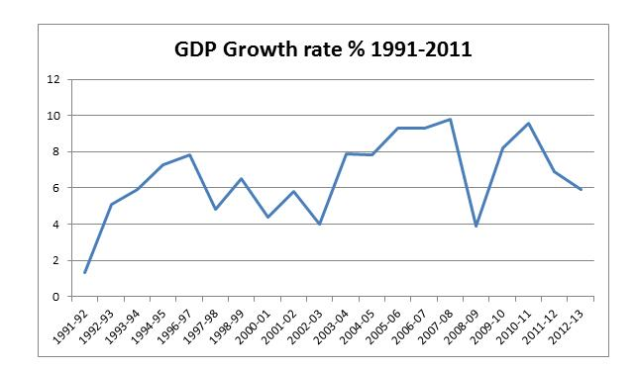

Slide 26
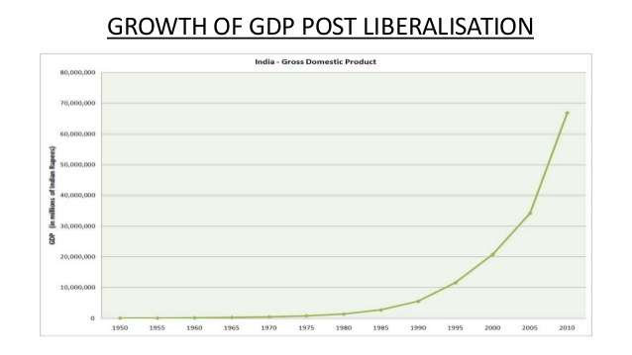

Slide 27
Although, India’s GDP was growing, however, the growth rate had become extremely low (less than 2%).
It is clearly visible from the first graph that after 1991, once the growth rate reached a certain minimum it did not go less than 4%.
The current GDP growth rate for 2015-16 was 7.5%, which was 0.2% more than the previous financial year.

Slide 28
Thank you

